Slide 1
North Point Software Company Production
- Established software company specializing in games and educational software.

Slide 2

Goals:
Maximize gross profit.
Optimize customer targeting for direct mail campaigns.

Slide 3
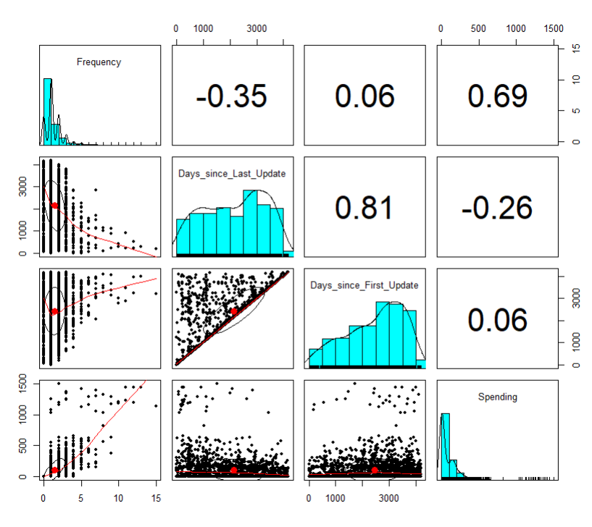
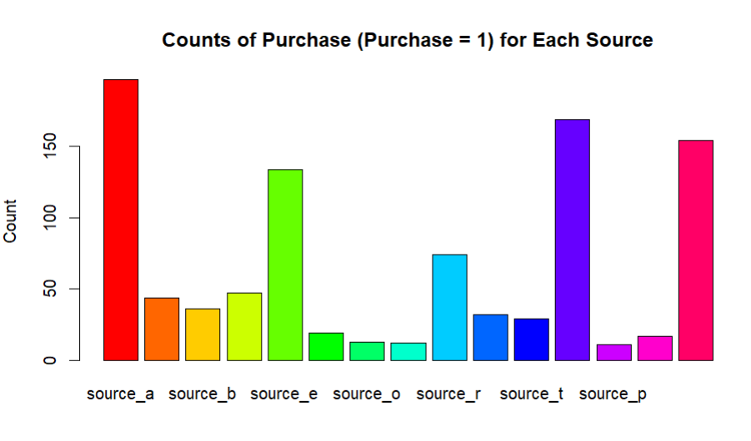
Data Exploration
The relation between each numeric attribute:
Checking for missing and zero values.
Analyzing outcome variables, categorical variables, and numeric attributes.
Distribution of All Sources When Purchased:

Slide 4
Predictor analysis
Removal of irrelevant attributes (sequence number).
Analysis of customers with all source attributes marked as 0 (indicating the customers are from their database).

Slide 5
Classification model
Logistic regression model with all predictors performs better for classification into purchasers and non-purchasers.
High accuracy and sensitivity are shown in the initial model, suggesting that the model is useful in anticipating customer replies and optimizing mailing campaigns.

Slide 6
Regression Model
Linear regression with backward selection provides actionable insights into customer spending patterns, enabling North-Point to improve marketing strategies and maximize profitability.
Backward selection ensures that only the most important predictors are included, which simplifies the model and lessens overfitting.
This approach improves prediction accuracy by focusing on significant predictors that have the greatest impact on customer spending behavior.

Slide 7

Holdout Data Analysis
Predicted Probability of Purchase: Provides insight into the likelihood of customers making a purchase.
Adjusted Probability of Purchase: Adjusts for purchaser oversampling to ensure accurate representation of real-world response rates, guiding more precise marketing strategies.
Predicted Spending Value: Enables estimation of the amount customers are likely to spend on purchases.
Expected Spending: Offers a more accurate estimate of customer’s expenses, considering oversampling.
Cumulative chart: Visualizes the efficiency of targeting methods by depicting cumulative expected spending, assisting in identifying high-value customer segments, and optimizing marketing campaign effectiveness.

Slide 8
Business Recommendations
Emphasis on constant assessment and adaptation of marketing initiatives and prediction models.
Utilization of the cumulative gain chart for optimizing marketing strategies and identifying high-value customer segments.

Slide 9

Thank you

